Slide 1



3rd Annual Don Conaway Partnering Awards

Slide 2
3rd Annual Don Conaway Partnering Award
ODOT/OCA Partnering Award Selection Committee
  Gary Angles, ODOT Central Office
  Chris Engle, OCA
  Jack Ford, The Beaver Excavating Company
  Keith Geiger, ODOT District 5
  Brad Jones, ODOT Central Office
  Eric Kahlig, ODOT Central Office
  David Ley, ODOT District 7
  Doug Shealy, Mosser Construction
  Dan Smith, John R. Jurgensen Company
  Bob Weaver, ODOT District 3
  Chase Wells, ODOT Central Office
Notes:
Brad
The partnering award selection process is conducted by the joint ODOT/OCA Partnering Steering Committee which is comprised of both ODOT Central Office and District, OCA, and Contractor members.
Starting next year, we are going to invite today’s winning Districts and Contractors as honorary judges in an effort to be more transparent as this award grows older.
Thank you to all the Committee members for their work on this award.

Slide 3
3rd Annual Don Conaway Partnering Award
Award Categories
  Category 1: Under $5 Million
  Category 2: $5 Million - $20 Million
  Category 3: Over $20 Million
Notes:
Brad
Partnering is all about processes and people …therefore it was important to publicly recognize those individuals who exemplified partnering best practices and were responsible for delivering a successfully Partnered project.
How the nomination process worked:
The nomination form is available on the Division of Construction Management’s Partnering webpage.
We sent out an announcement signed by the Director and Chris Runyan in the middle of October as a reminder.
Nominations were made concurrently by the Prime Contractor or ODOT and were to be emailed to Chase Wells, ODOT’s Partnering Coordinator.
Projects were placed in one of the three categories based on project size.
Category 1: ORIGINAL CONTRACT AMOUNT Under $5 Million
Category 2: $5 Million - $20 Million
Category 3: Over $20 Million

Slide 4
3rd Annual Don Conaway Partnering Award
Eligibility Requirements
  Projects substantially completed by Jan. 9th, 2015
  All ODOT let construction projects are eligible
  One nomination per project
  Nominated concurrently by Contractor or ODOT
Notes:
Brad
Projects that were ELIGIBLE for this year’s award:
needed to be substantially complete by December 31st
limited to projects SOLD by ODOT
the number of times a project could be nominated to 1
A project can be nominated by anyone…either a Contractor or ODOT

Slide 5
3rd Annual Don Conaway Partnering Award
Selection Criteria
  Establishment and achievement of goals
  Management of Key Stakeholder relationships
  Subcontractor involvement in the Partnering Process
  Safety Record of the Project
  Challenges encountered and means to overcome
  Mitigation Efforts to reduce the risk of claims
  Project completion On Time and within Budget
  Value Engineering Change Proposals
  Demonstration of Partnering Values
Notes:
Brad
These are the Selection Criteria…they mirror the Statewide Partnering Goals.
The Selection Committee felt the strongest applicants for this year’s award submitted projects that…
Took a Proactive approach to Partnering as opposed to reactive. All Project Teams submitted quality nominations but it was obvious to the Steering Committee who took a proactive approach from the onset.
Utilized the Dispute Resolution Process. The committee encourages project teams to apply ODOT Dispute Resolution Process. We understand that Partnering does not always mean teams agreed on everything but rather worked together to reach a resolution.
Displayed original minutes from partnering meetings. The committee wants to see the project team actually set aside time for Partnering on the projects. This is also a huge benefit when the Selection Committee applies for national awards such as the Marvin Black Award and the International Partnering Institute Awards.
Showcased correspondence letters from various project stakeholders complimenting the partnering process.
Before getting into the nominations, the Steering Committee would like to thank the project teams for their time and effort. Your quality grows every year and we had 16 nominations for 2015; a new record!

Slide 6
Category 1: Under $5 Million Nominee
Project: 14-0075 Village of Pettisville Safe Routes to School
District: 2
Prime: Smith Paving and Excavating, Inc.
Original Contract Price: $294,365
Description: Safe Routes to School funding for improving sidewalks, constructing curb ramps, installing signing and striping, and other pedestrian infrastructure improvements.
Notes:
Chris
Category 1: Projects under $5 million
We had 7 projects that were nominated for this category.
The 1st nominee was…(read info from slide)
ODOT Project Engineer: Steve Trausch
Prime Contractor Project Manager: Aaron Smith

Slide 7
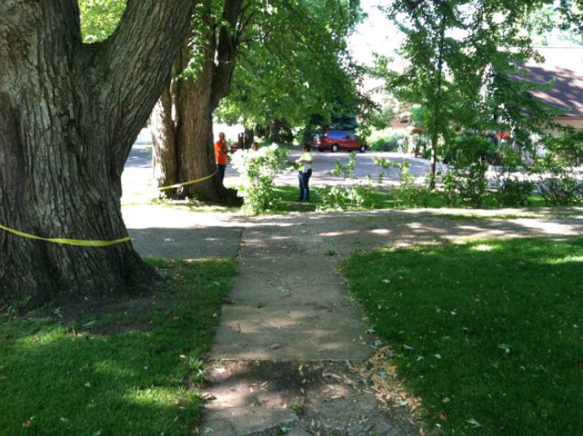
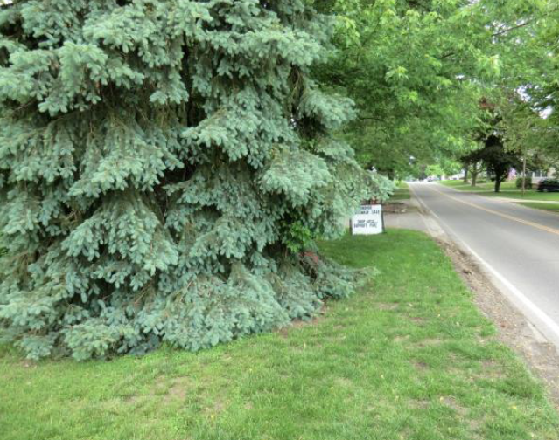
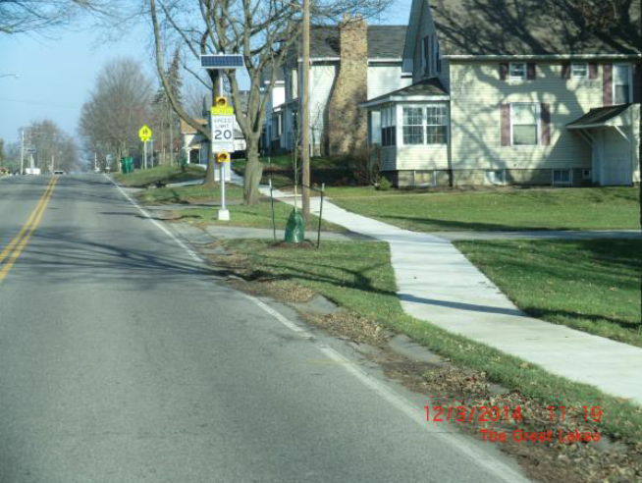
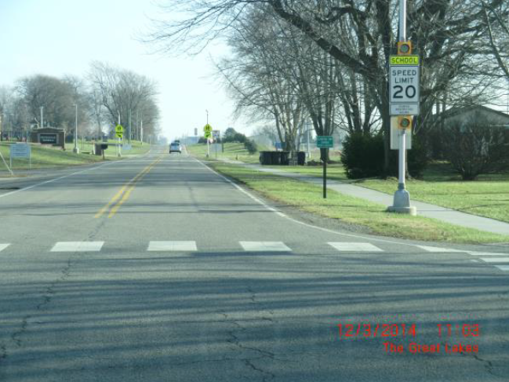
Category 1: Under $5 Million Nominee
Notes:
Chris
Major Project Challenges:
Outcry from the General Public on the removal of the existing trees.
After a plan redesign, the Project was left with 14 trees that could not be restocked by the Nursery Subcontractor.

Slide 8
Category 1: Under $5 Million Nominee
Project: 13-0520 (WOO – 20/25)
District: 2
Prime: Shelly Company
Original Contract Price: $883,987
Description: Improving sections of US20 and SR25 in the City of Perrysburg.
Notes:
Chris
The 2nd nominee was…(read info from slide)
ODOT Project Engineer: Kacey Smith
Prime Contractor Project Manager: Tom Haar

Slide 9
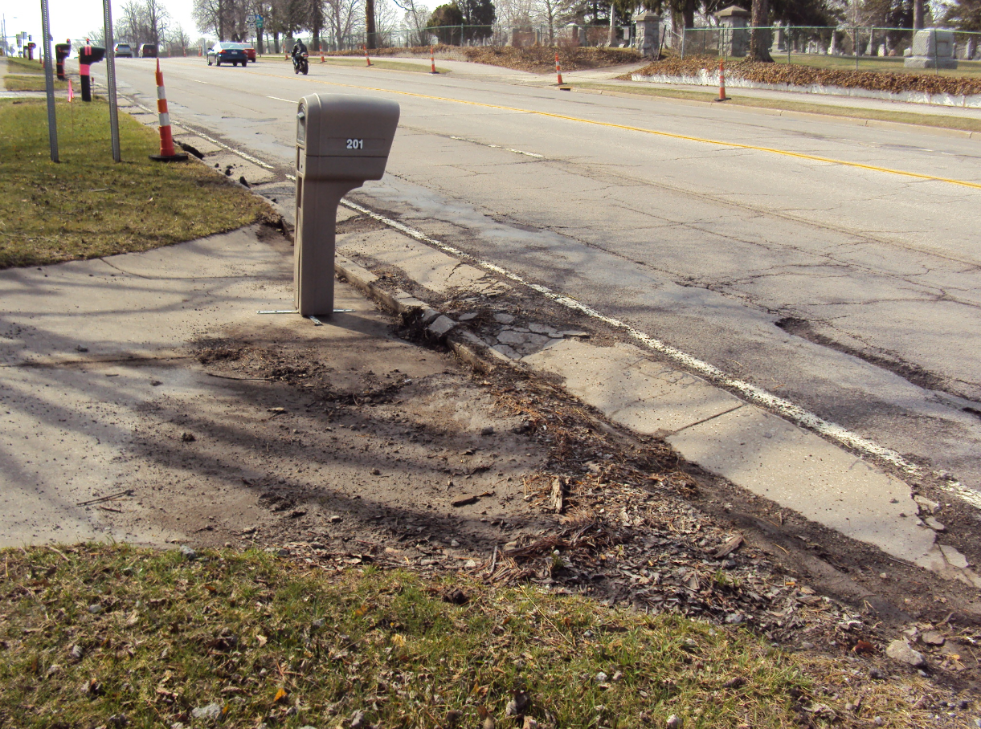
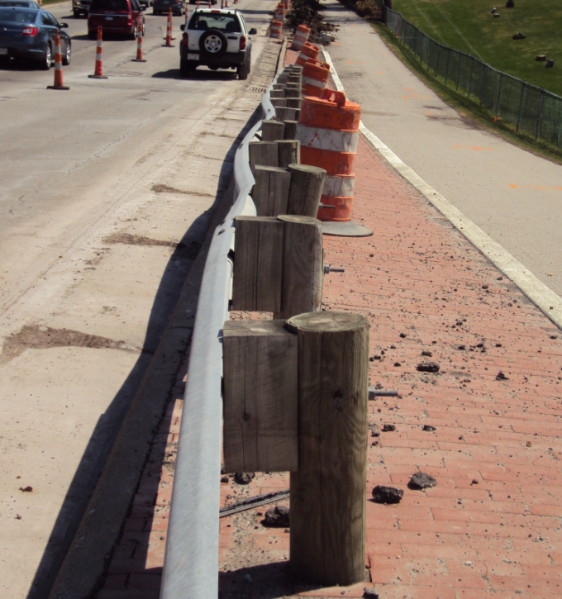
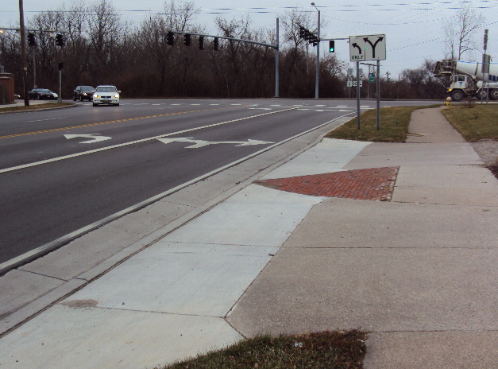
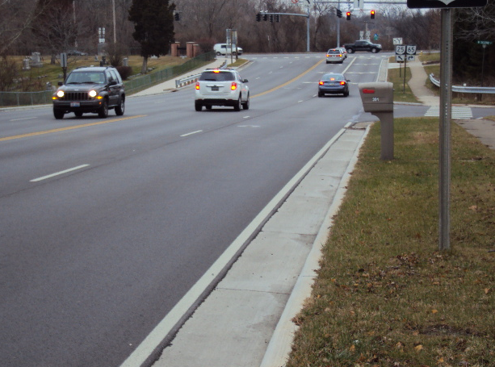
Category 1: Under $5 Million Nominee
Notes:
Chris
Major Project Challenges:
Providing access to 14 businesses and 9 residents because of curb and gutter operations.
High traffic volumes and performing work at the US20 SR 25 interchange.

Slide 10
Category 1: Under $5 Million Nominee
Project: 13-3009 (Portage – Rock Springs Rd.)
District: 4
Prime: J.D. Williamson
Original Contract Price: $1,737,187
Description: Design Build bridge replacement with new galvanized steel girders over West Branch Reservoir.
Notes:
Chris
The 3rd nominee was…(read info from slide)
ODOT Project Engineer: John Mazzola
Prime Contractor Project Manager: Steve Hermann

Slide 11
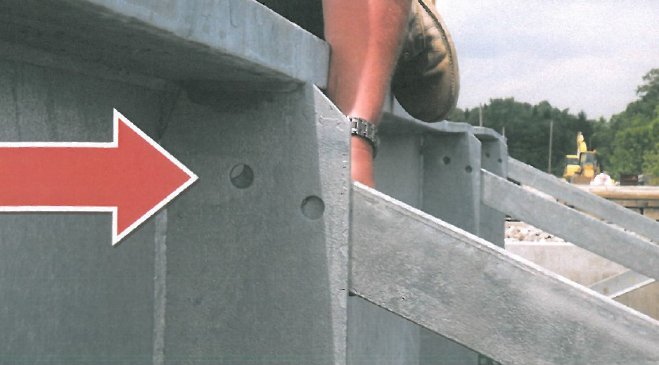
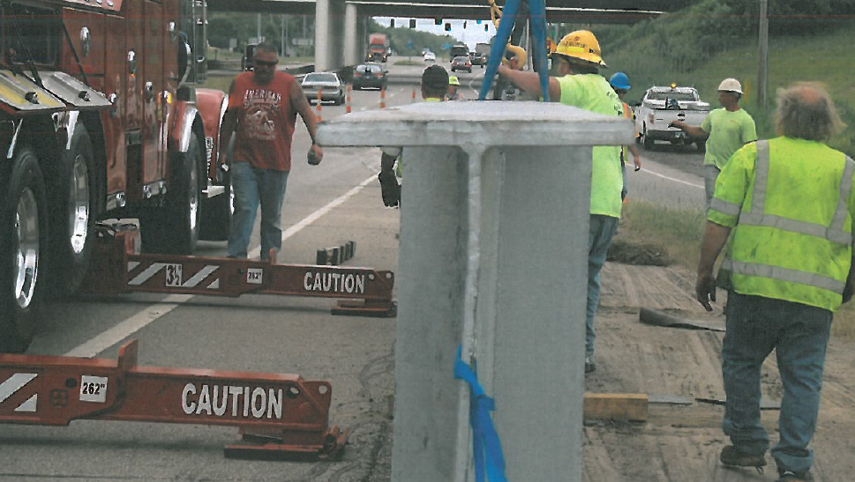
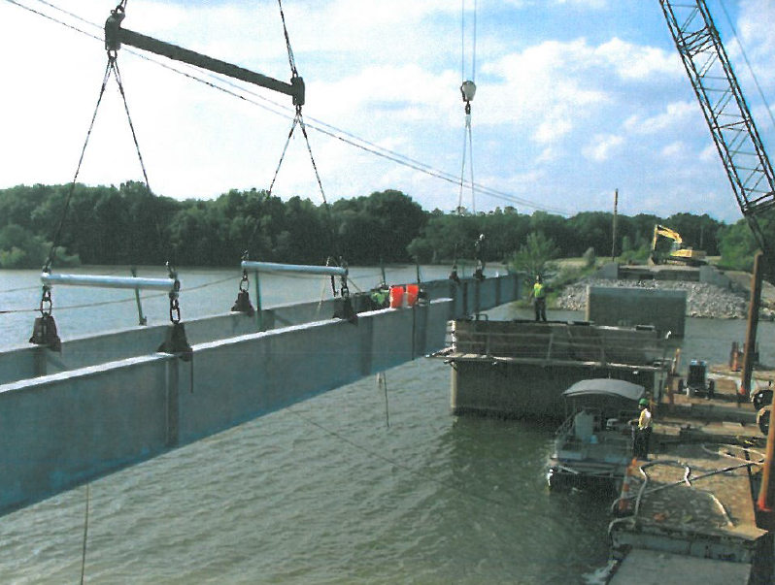
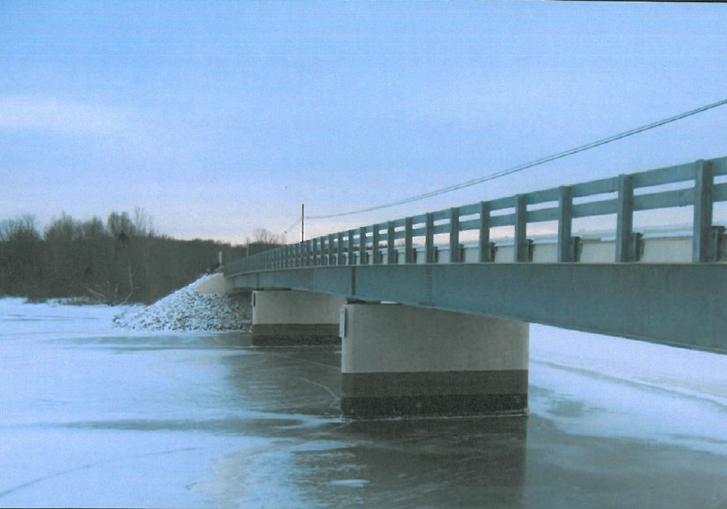
Category 1: Under $5 Million Nominee
Notes:
Chris
Major Project Challenges:
Steel Mill delays.
Fabrication errors.
Warping of the girders from the galvanizing process.
Trucking company losing a load of girders on the highway.
Higher than anticipated water levels.
Misaligned bolt holes on the X-Frames.

Slide 12
Category 1: Under $5 Million Nominee
Project: 14-0202 (CLA – 41/235 Roundabout)
District: 7
Prime: Double Z Construction
Original Contract Price: $1,026,836
Description: Construction of a single lane roundabout at the intersection of SR41 and SR235 in Clark County.
Notes:
Chris
The 4th nominee was…(read info from slide)
ODOT Project Engineer: Michelle Porr
Prime Contractor Project Manager: Larry Lyons

Slide 13
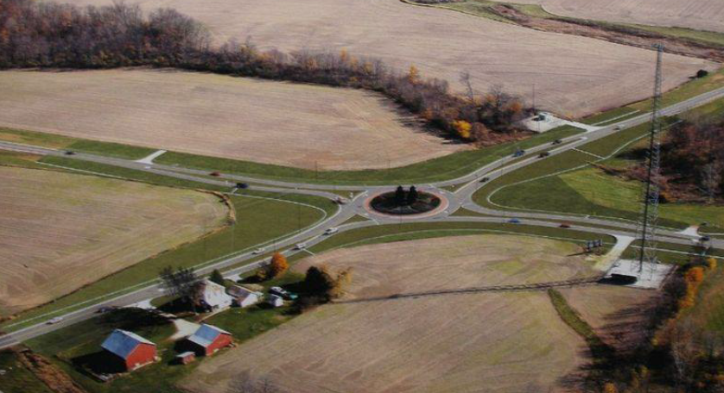
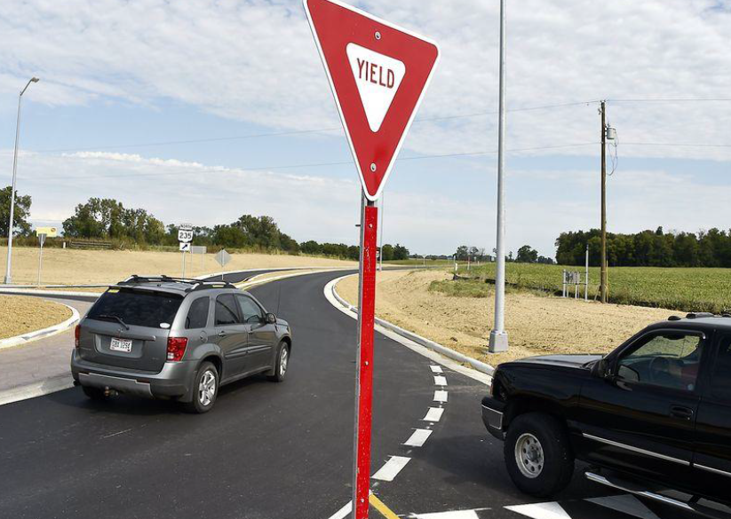
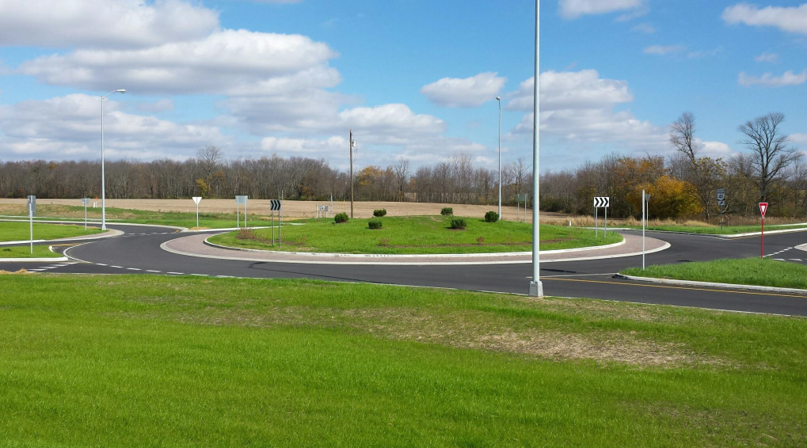
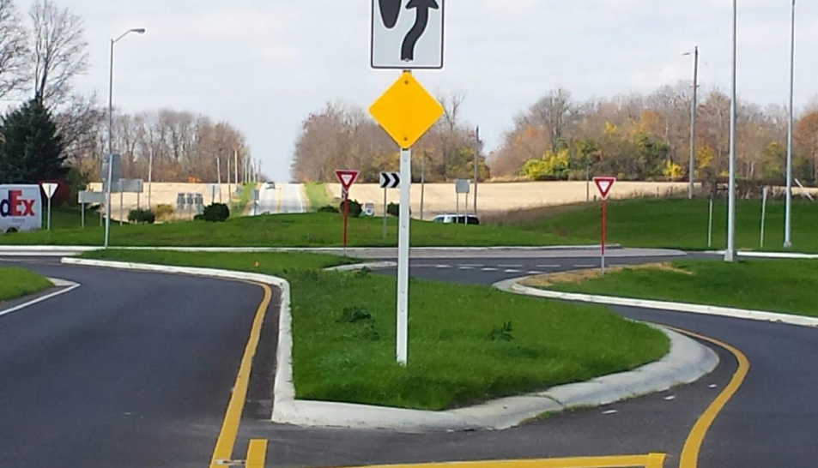
Category 1: Under $5 Million Nominee
Notes:
Chris
Major Project Challenges:
Managing a MOT scheme that called for 3 of the 4 phases to be run directly through the central, circular island.
Dealing with an existing telephone line that was discovered to be three feet above the proposed temporary pavement.

Slide 14
Category 1: Under $5 Million Nominee
Project: 13-9010 (HAR – US22)
District: 11
Prime: Turn-Key Tunneling
Original Contract Price: $1,727,045
Description: Removal of a collapsed drainage culvert beneath US22 at Piedmont Lake and installing an 84” tunnel liner plate followed by a new 60” culvert. (Emergency Project)
Notes:
Chris
The 5th nominee was…(read info from slide)
ODOT Project Engineers: Jerred Giauque/ Todd Moore
Prime Contractor Project Manager: Brian Froehlich

Slide 15
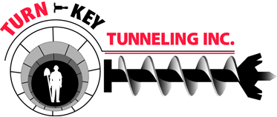
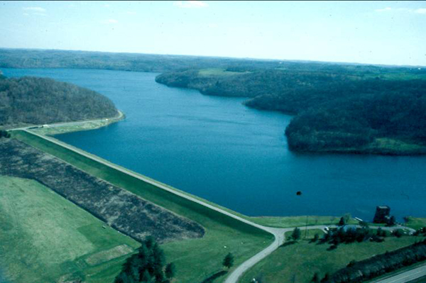
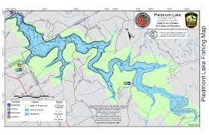
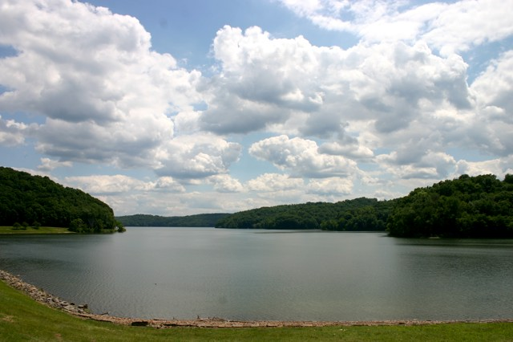
Category 1: Under $5 Million Nominee
Notes:
Chris
Major Project Challenges:
Maintaining traffic for the Shale Gas Industry
Culvert was positioned 50’ below US 22.
Extensive bypass pumping to control the discharge of water from Piedmont Dam

Slide 16
Category 1: Under $5 Million Nominee
Project: 13-0383 (LOR – 611)
District: 3
Prime: Mosser Construction Company
Original Contract Price: $4,795,460
Description: Repaired and resurfaced 1.5 miles of asphalt pavement, widened a bike lane and widened and rehabbed a bridge over I-90 in the City of Avon.
Notes:
Chris
The 6th nominee was…(read info from slide)
ODOT Project Engineers: Luke Wysocki
Prime Contractor Project Manager: Jorge Baez

Slide 17
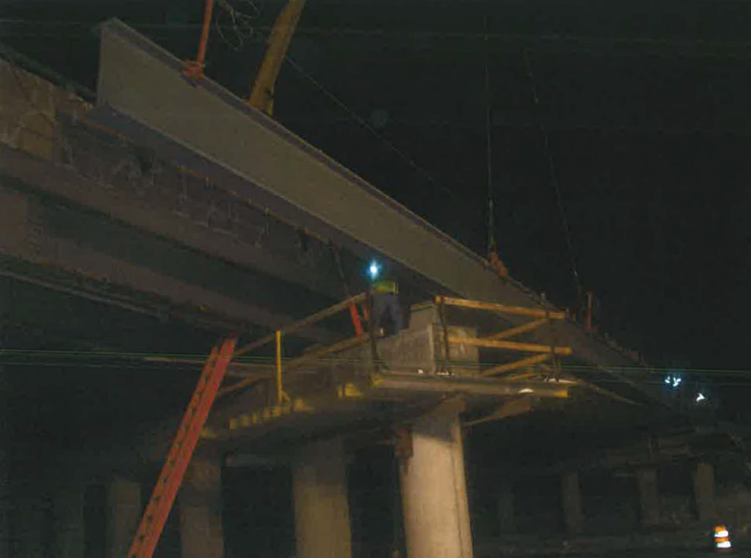

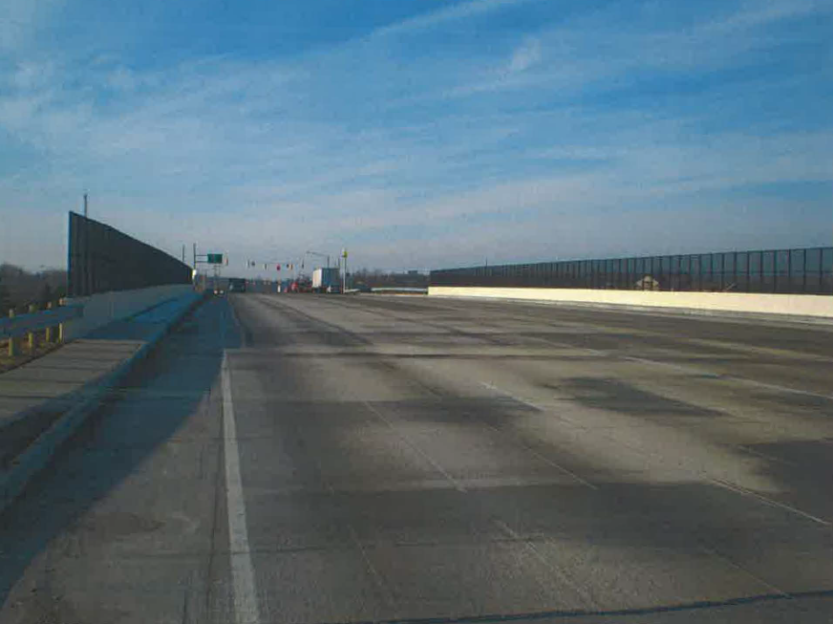
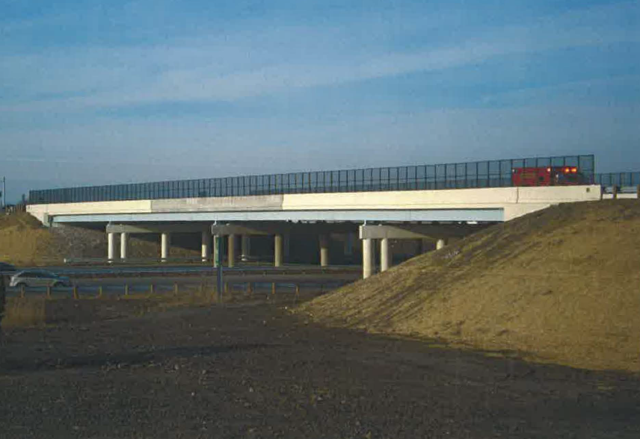
Category 1: Under $5 Million Nominee
Notes:
Chris
Major Project Challenges:
Engineering the project phasing in order to build the proposed substructure widening work and the subsequent deck replacement in a timely manner.
Anticipated screed elevations for the new bridge deck did not rebound as expected.
Squeezing in the steel bridge painting near the end of the construction season.

Slide 18
Category 1: Under $5 Million Winner!
Project: 13-2007 (District 1 Campus)
District: 1
Prime: Mosser Construction Company
Original Contract Price: $4,219,500
Description: Construct five new buildings and renovate two existing building to allow District 1 to consolidate all district and Allen Co. work units into a single campus.
Notes:
The final nominee for this category was…(read info from slide)
The committee selected this project as the Award Winner for the first category.
WHY?
Project was PROACTIVE with Partnering; Co-facilitated between District 1 DCA, Darren Schimmoeller and Mosser VP Doug Shealy.
Project Team developed a plan to split the office renovation into three phases with downtime to allow employees to both continue work and relocate.
Project Team solicited input from the building occupants before making any decisions.
Utilized the Dispute Resolution Process.
Project finished over 57 days ahead of schedule and within budget.
Established a communication protocol to manage correspondence with all stakeholders.
Mosser assisted ODOT in learning about Vertical Construction and ODOT assisted Mosser in learning about ODOT’s processes.
Perfect safety record.
We have a short video to further highlight the success of this project.
We would like the project representatives to come up on the stage to accept their award at this time.
(Brian Rader and Chris Hughes) representing ODOT District 1
(Shawn Tooman, Dan Shroeder, Doug Shealy) representing the Mosser Construction Company

Slide 19
Category 2: $5 Million - $20 Million Nominee
Project: 13-0493 (Pickaway East-West Connector)
District: 6
Prime: Trucco Construction
Original Contract Price: $6,541,131
Description: Major reconstruction of Ashville Pike that spans from Duvall Road to Rickenbacker Parkway. Phase 2 of 4 designed to create a direct corridor from US23 to the Rickenbacker Intermodal facility.
Notes:
Chris
Category 2: Projects between $5Million and $20Million.
We had 6 projects that were nominated for this category.
The 1st nominee was…(read info from slide)
ODOT Project Engineer: Jacob Slechter
Prime Contractor Project Manager: Tim Maiden & Brad Mcloughlin

Slide 20
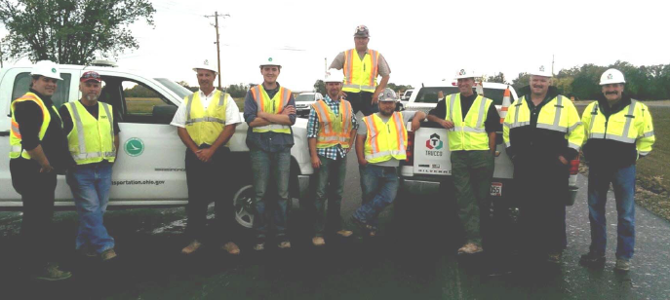
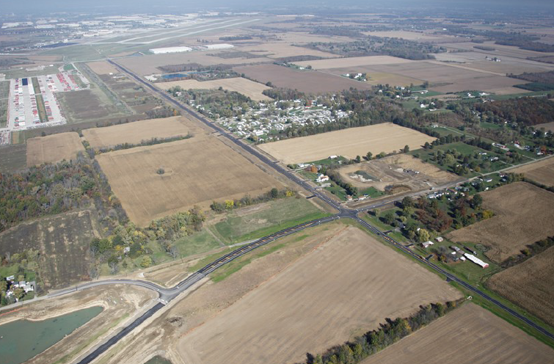
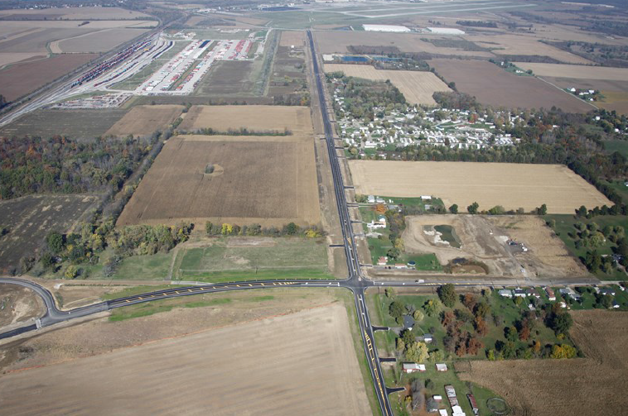
Category 2: $5 Million - $20 Million Nominee
Notes:
Chris
Major Project Challenges:
Overcoming MOT obstacles to prevent utility delays from overhead power lines.
Working adjacent to a project that presented redundant work and MOT coordination.
A change in Project Managers by the Contractor.

Slide 21
Category 2: $5 Million - $20 Million Nominee
Project: 13-0086 (SR 32 Eastgate Blvd. Interchange)
District: 8
Prime: Sunesis Construction Company
Original Contract Price: $9,039,296
Description: Reconfiguration of the interchange at SR32 and Eastgate Boulevard in Clermont County. Replacement of the Eastgate Bridge over SR32. Reconstruction of Eastgate through the business district.
Notes:
Chris
The 2nd nominee was…(read info from slide)
ODOT Project Engineer: Jason Haus
Prime Contractor Project Manager: Robert Doyle

Slide 22



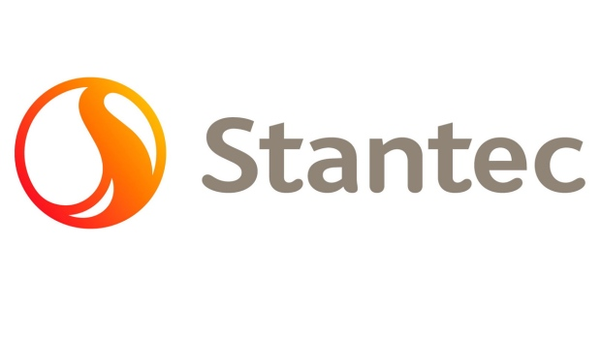
Category 2: $5 Million - $20 Million Nominee
Notes:
Chris
Major Project Challenges
Coordinating with two adjacent projects that had a direct effect on each other.
Clermont County Engineer’s Office requested a “Holiday” phase which required the project to finish Phase 1 two months early.

Slide 23
Category 2: $5 Million - $20 Million Nominee
Project: 13-0419 (City of Lancaster)
District: 5
Prime: Shelly Company
Original Contract Price: $7,590,290
Description: Asphalt resurfacing on US22, SR37, SR58 and SR 188 within the City of Lancaster. Full depth removal and replacement with concrete pavement on Main St. (US22).
Notes:
Chris
The 3rd nominee was…(read info from slide)
ODOT Project Engineer: Munjed Kara-Hamound
Prime Contractor Project Manager: Ben Koehler

Slide 24
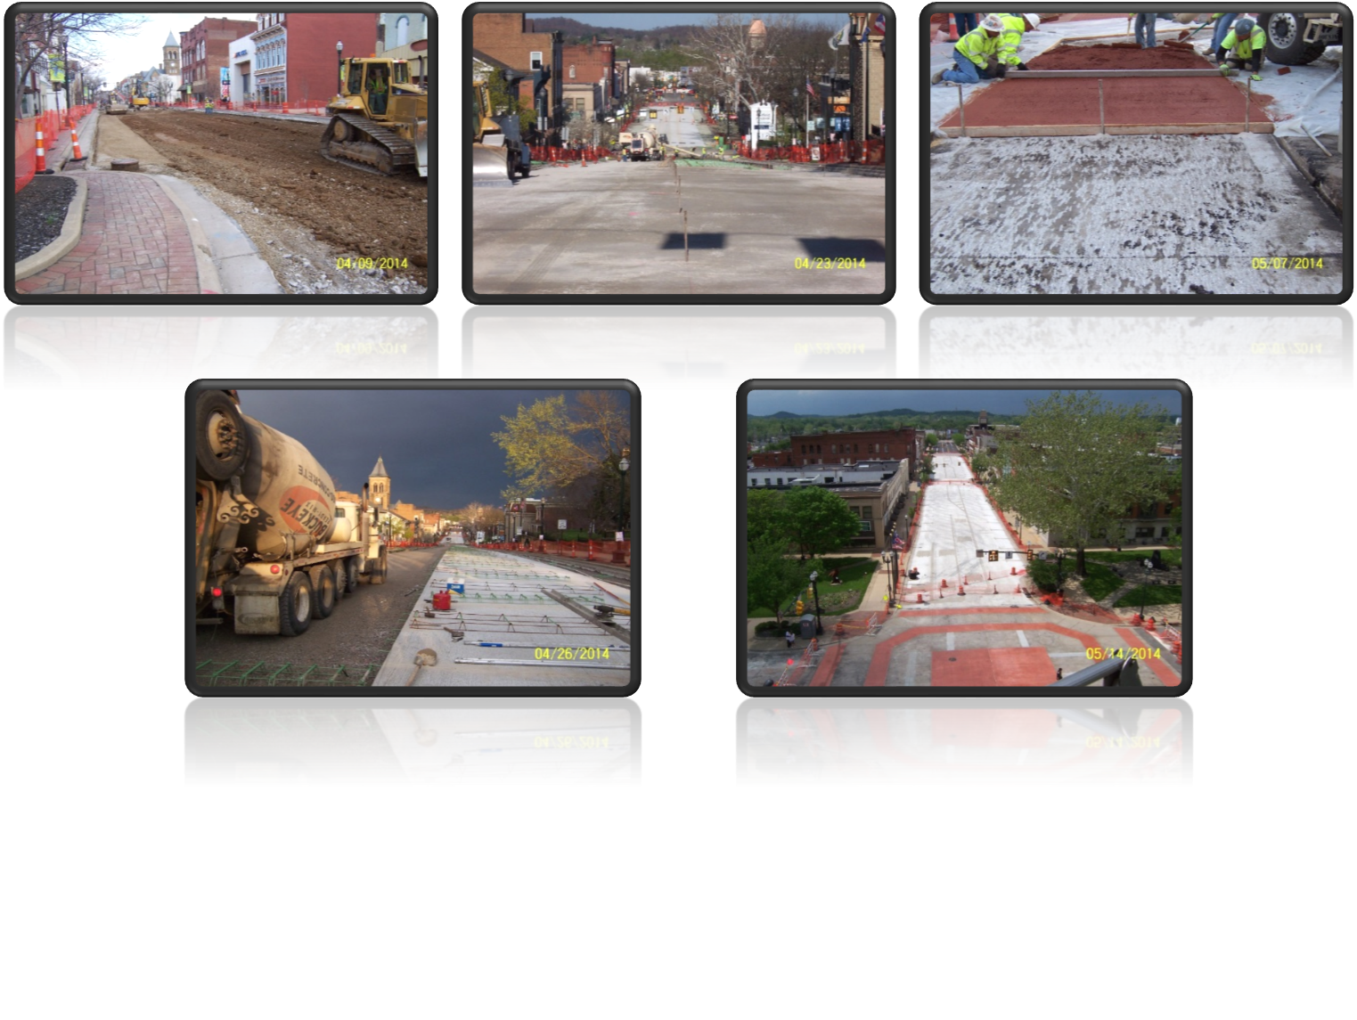
Category 2: $5 Million - $20 Million Nominee
Notes:
Chris
Major Project Challenges:
Schedule and perform work on a multi-year, multi-phase project in the business district without creating conflicts with business owners.
Discovery of an unmarked 19th century trolley track that ran the entire length of the section in the middle of the roadway.
Accommodating the City’s Festivals and County Fair.

Slide 25
Category 2: $5 Million - $20 Million Nominee
Project: 13-0476 (Ashtabula Lake Road Revetment)
District: 4
Prime: Mark Haynes Construction, Inc.
Original Contract Price: $6,437,629
Description: Reconstruction of the existing revetment along Lake Erie shoreline adjacent to SR 531 (Lake Road). Work included resurfacing and shoulder widening, improved drainage and traffic control.
Notes:
Chris
The 4th nominee was…(read info from slide)
ODOT Project Engineer: Larry Obhof
Prime Contractor Project Manager: Craig Smith

Slide 26
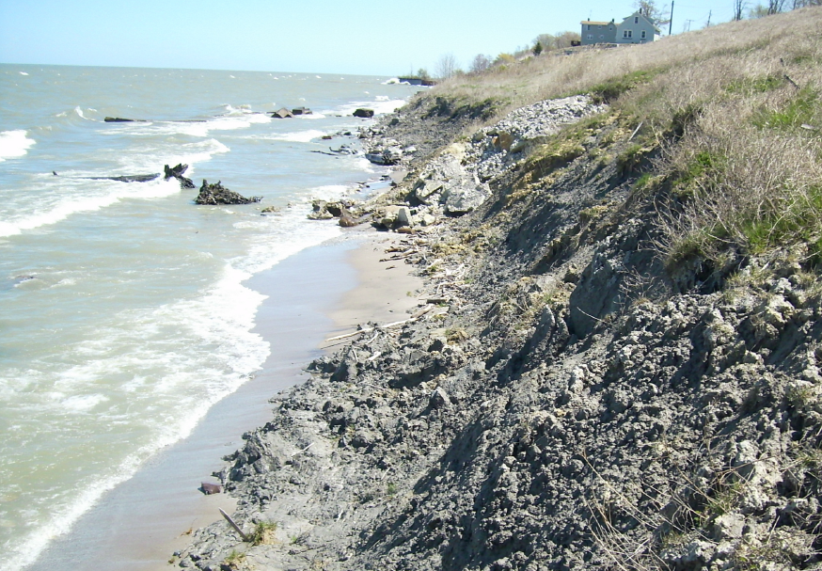
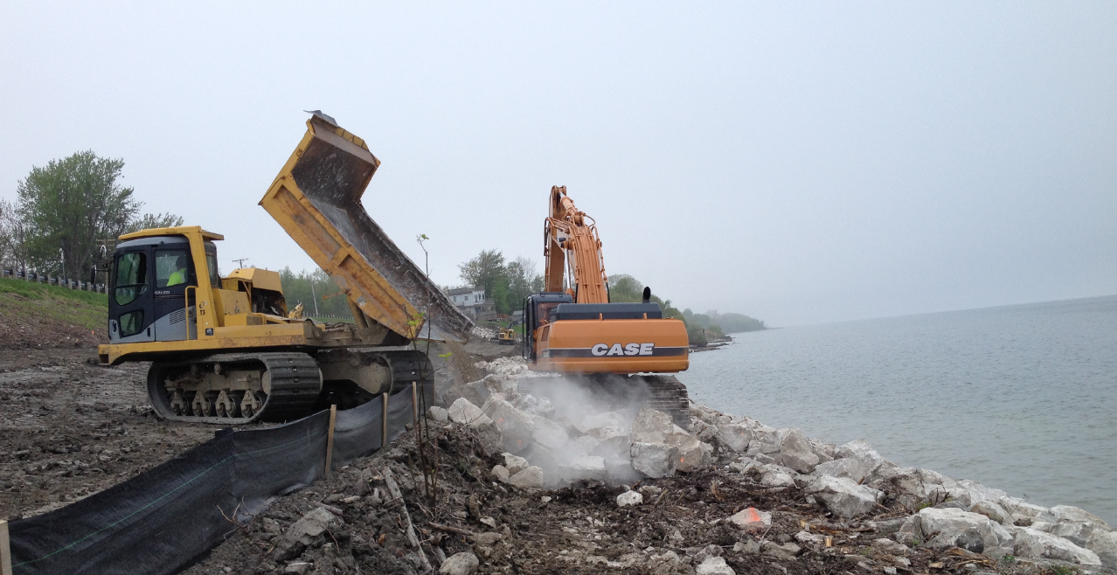
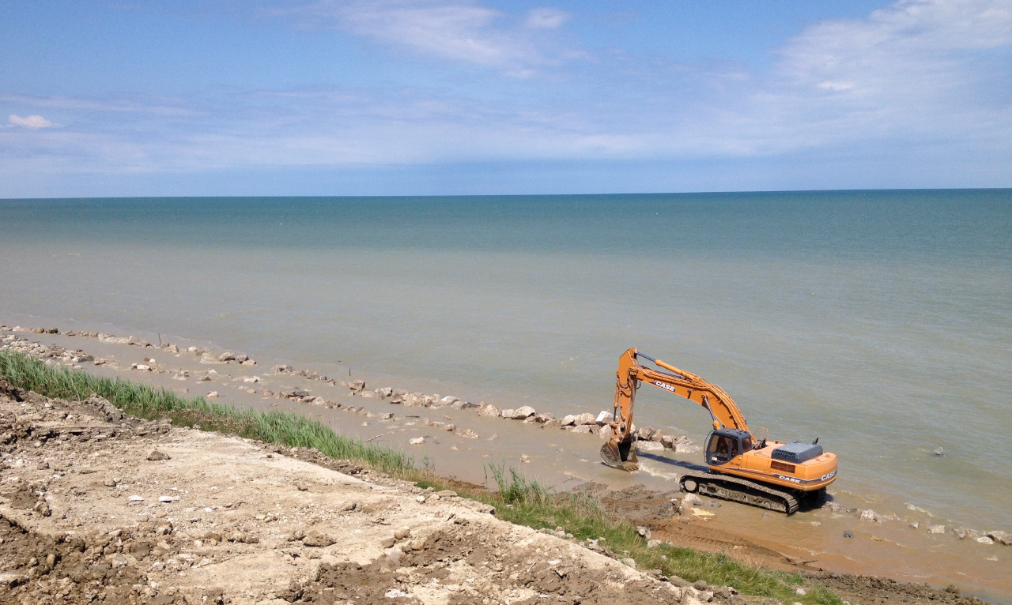
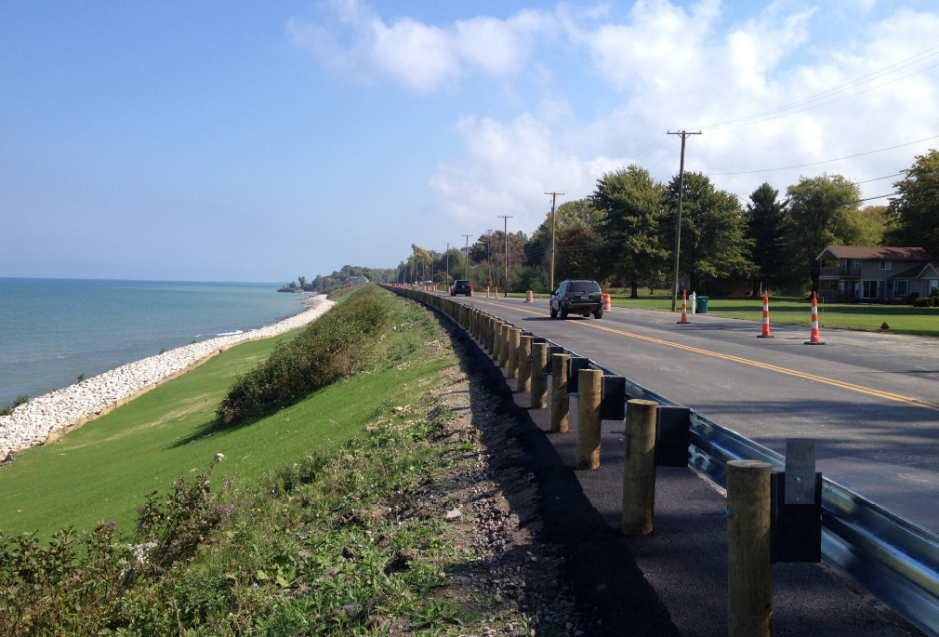
Category 2: $5 Million - $20 Million Nominee
Notes:
Chris
Major Project Challenge:
Unpredictable weather along the shore. At times, large waves off the lake prevented work.

Slide 27
Category 2: $5 Million - $20 Million Nominee
Project: 12-0118 (Medina I-75)
District: 3
Prime: Shelly and Sands
Original Contract Price: $17,785,160
Description: Repaired and resurfaced 4.5 miles of Interstate 76/US 224, added and replaced an acceleration ramp, and repaired/resurfaced all other ramps at three interchanges.
Notes:
Chris
The 5th nominee was…(read info from slide)
ODOT Project Engineer: Scott Turcheck
Prime Contractor Project Manager: Chris Newhouser

Slide 28
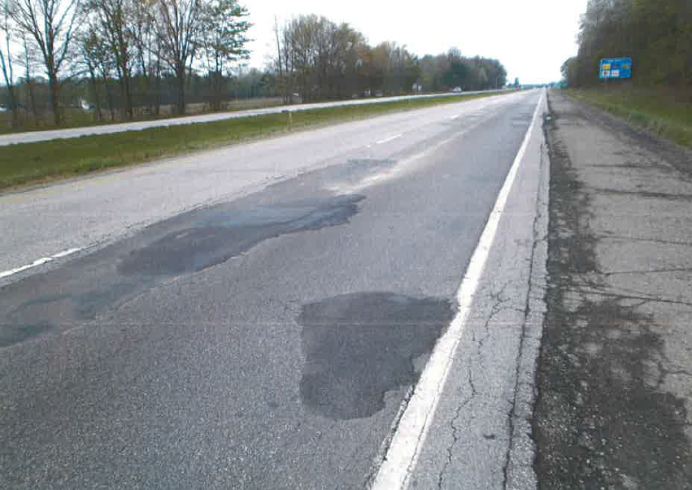
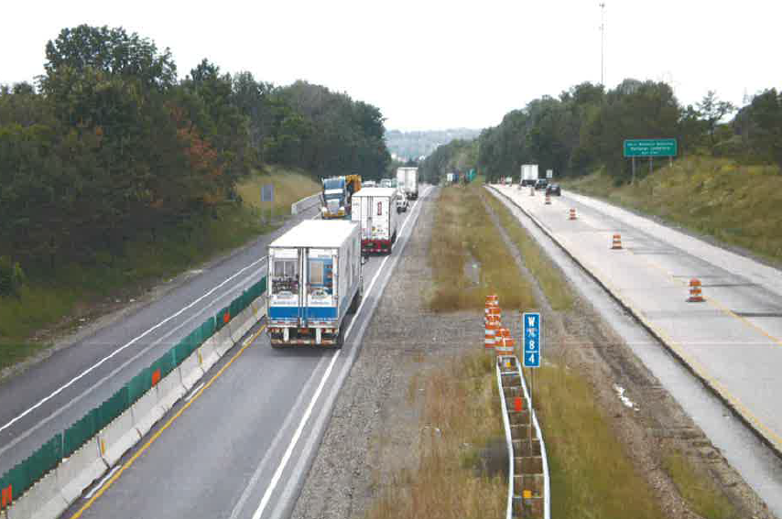
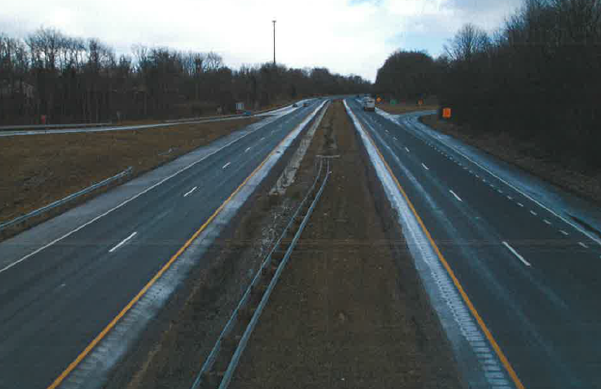
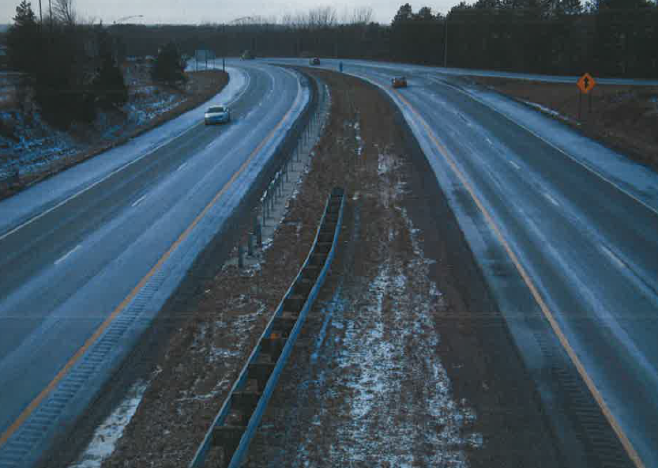
Category 2: $5 Million - $20 Million Nominee
Notes:
Chris
Major Project Challenges:
Full depth repairs of shoulders because of poor conditions not stated in the plans.
Maintaining a safe work zone because of speeding motorist.
Confined work zones.
Developing and executing a workable MOT from high volumes of traffic.

Slide 29
Category 2: $5 Million - $20 Million Winner!
Project: 13-0586 (I-75/224 Interchange)
District: 1
Prime: Miller Brothers Construction
Original Contract Price: $10,648,577
Description: Complete reconstruction of the I-75 and US24 interchange in the City of Findlay.
Notes:
The final nominee for this category was…(read info from slide)
The committee selected this project as the Award Winner for the first category.
WHY?
Project was PROACTIVE with Partnering
Followed the Chain of Command set forth in the Initial Partnering Session.
All issues were able to be solved at the Project level.
Innovative MOT plans.
Zero recordable safety injuries throughout the life of the Project.
Ohio State Attire Fridays
Provided high detailed Partnering transcripts.
On budget/ On time.
We have a short video to further highlight the success of this project.
We would like the project representatives to come up on the stage to accept their award at this time.
(Karen Shiarla and Chris Hughes) representing ODOT District 1
(Ryan Bernath & Randy Varner, Project Superintendents) representing Miller Brothers Construction.

Slide 30
Category 3: $20 Million+ Nominee
Project: 10-3000 (CCG1: I-90 Innerbelt Bridge Replacement)
District: 12
Prime: Walsh Construction Company
Original Contract Price: $287,400,000
Description: Replacing the 1959 Interstate I-90 Bridge that spans the Cuyahoga River and serves as a gateway into the heart of downtown Cleveland’s sports and entertainment district.
Notes:
Chris
Category 3: Projects over $20Million.
We had 3 projects that were nominated for this category.
The 1st nominee was…(read info from slide)
ODOT Project Engineer: Tom Hyland
Prime Contractor Project Manager: John Tracy

Slide 31
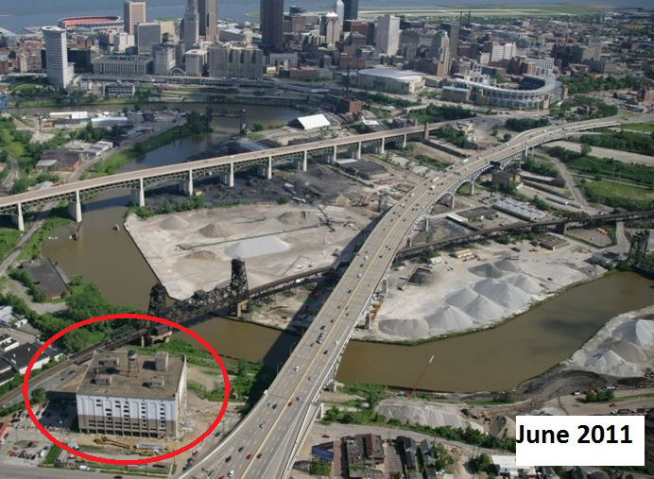
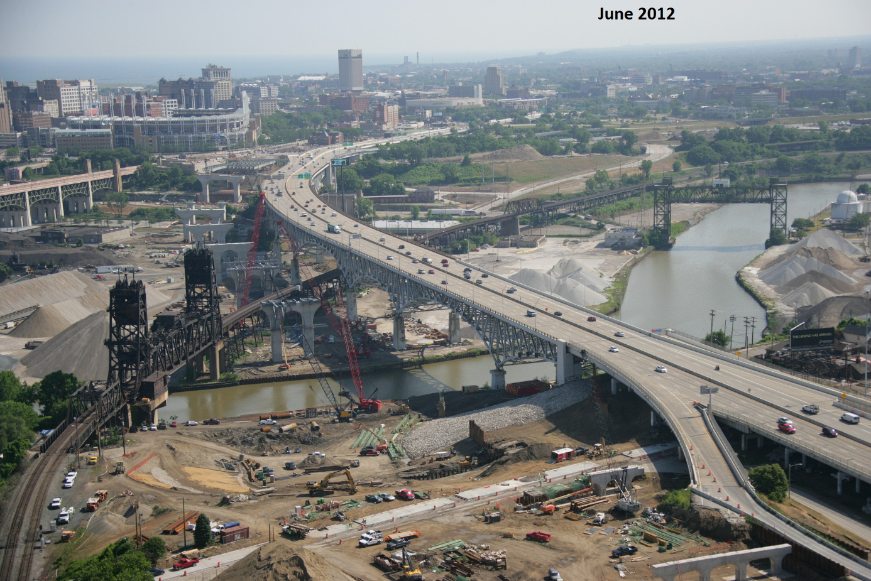
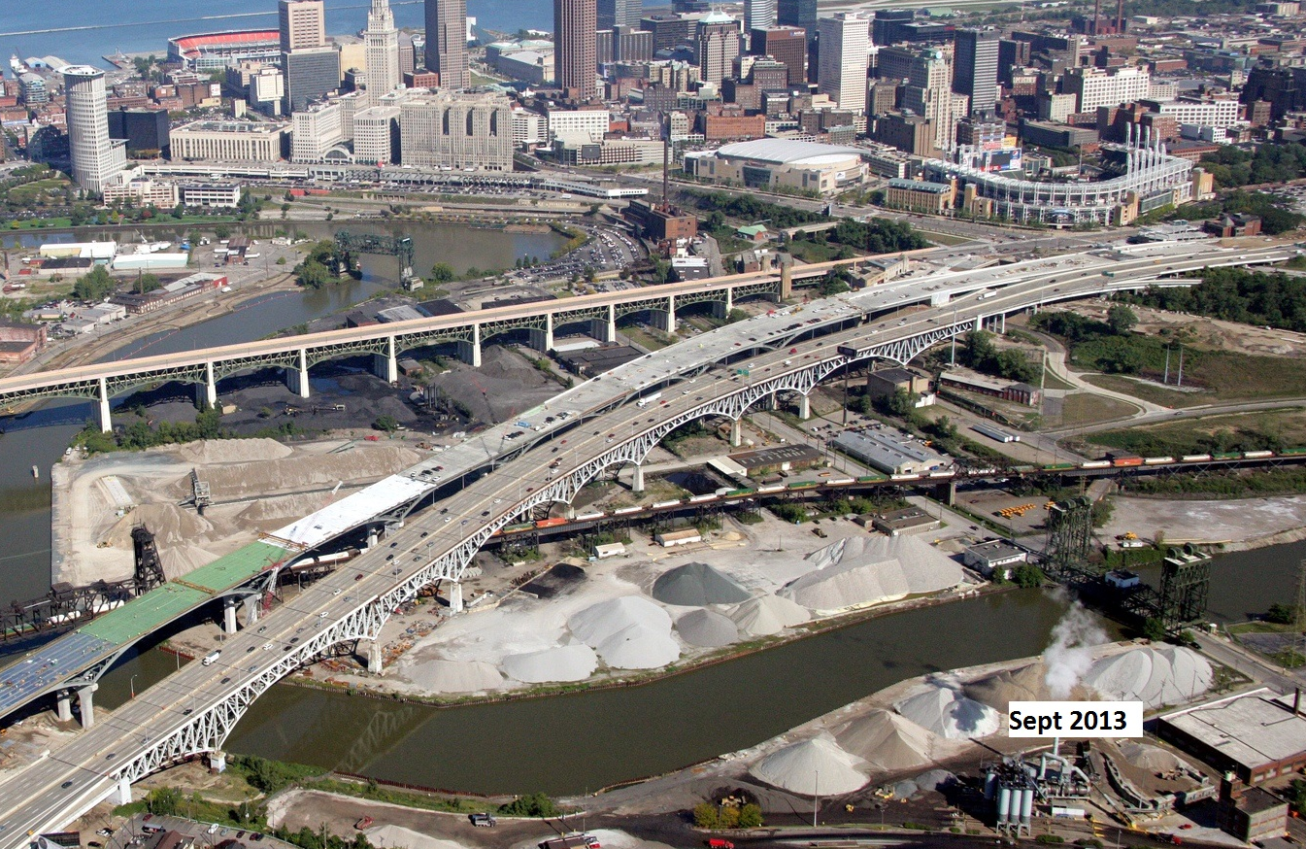
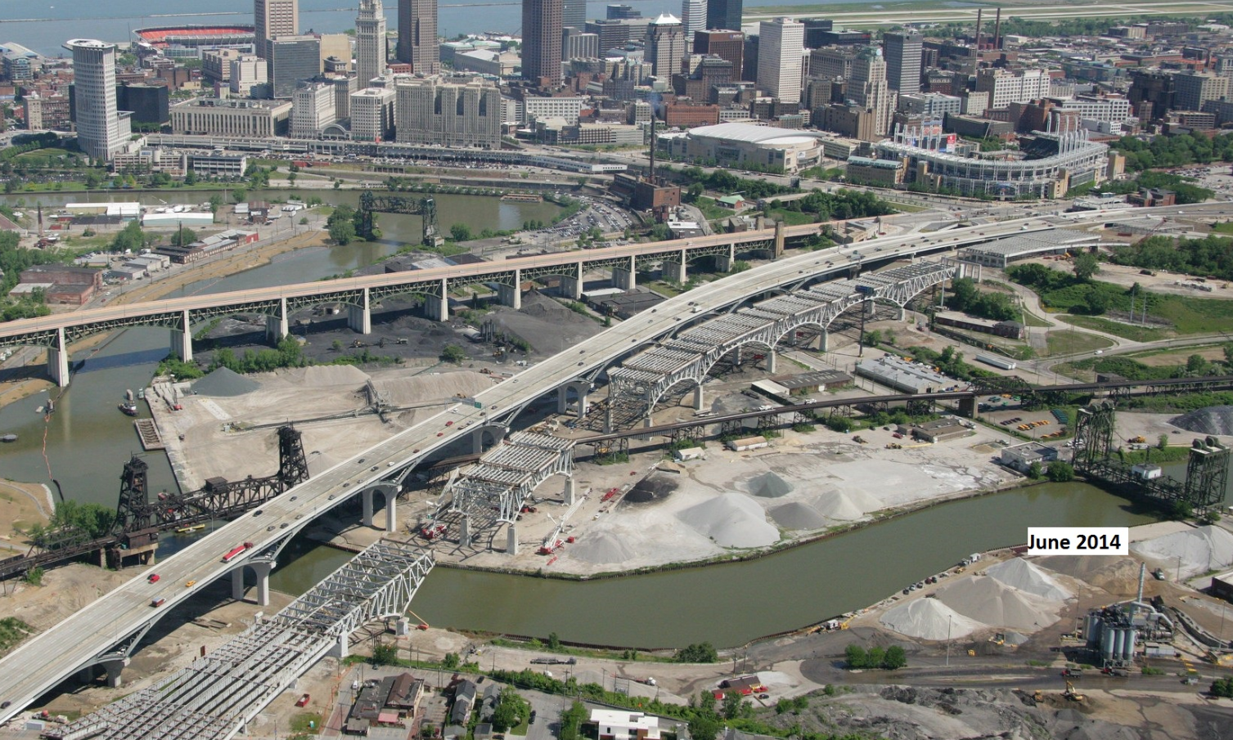
Category 3: $20 Million+ Nominee
Notes:
Chris
Major Project Challenges:
Managing four independent railroad companies and 17 separate utilities within the footprint of the work.
Restrictive MOT parameters associated with construction in the Downtown Cleveland environment.
Manage 121 Subcontractors
Dealing with unforeseen contaminated items.
Coordinating and relaying prompt and accurate information to the traveling public, local residents and businesses.

Slide 32
Category 3: $20 Million+ Nominee
Project: 11-0255 (WaldVogel Memorial Viaduct)
District: 8
Prime: The Great Lakes Construction Company
Original Contract Price: $54,942,000
Description: Removal of the existing WaldVogel Viaduct, including four ramps to Elberon & Warsaw Avenues. Replacement of structures on both Elberon and Warsaw for the connection of the 6th St. Expressway.
Notes:
Chris
The 2nd nominee was…(read info from slide)
ODOT Project Engineer: Cory Carfora
Prime Contractor Project Manager: Jeff Darrah

Slide 33
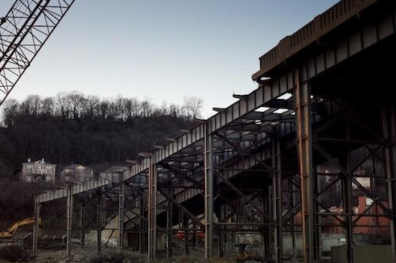
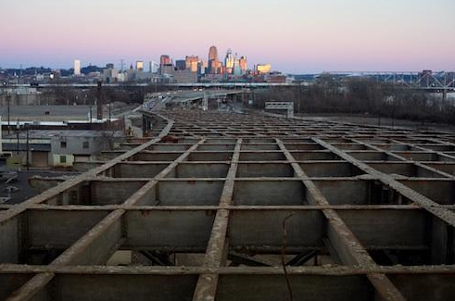
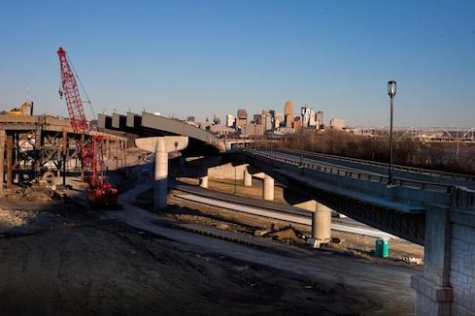
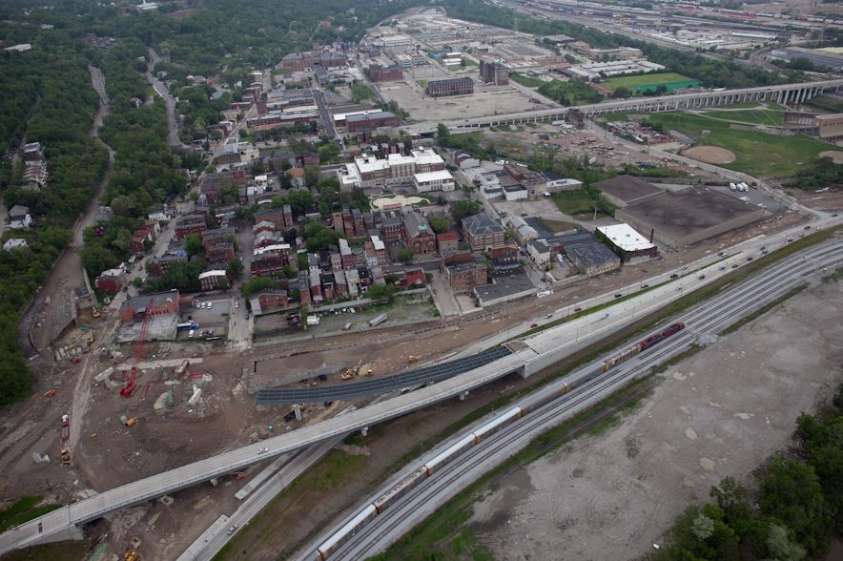
Category 3: $20 Million+ Nominee
Notes:
Chris
Major Project Challenges:
Redesign of pier footers in Mill Creek during construction.
Encountered 2 razed bridges submerged in Mill Creek that prevented plan design from being constructed.
Remnants of 1909 and 1942 bridges laid just beneath the creek basin and required one full year of underwater excavation.

Slide 34
Category 3: $20 Million+ Winner!
Project: 09-1080 (Nelsonville Bypass Phase 3)
District: 10
Prime: Beaver Construction
Original Contract Price: $92,878,443
Description: Approximately 4 miles of roadway construction consisting of 7M cubic yards of excavation and 4.4M cubic yards of embankment, 10 bridges and over 26,000 feet of drainage.
Notes:
The final nominee for this category was…(read info from slide)
The committee selected this project as the Award Winner for the first category.
WHY?
Project was PROACTIVE with Partnering.
Followed the Chain of Command set forth in the Initial Partnering Session.
Project was co-facilitated between District 10 DDD, Steve Williams and Beaver VP Jack Ford.
Utilized the Dispute Resolution Process.
Co-facilitated for strengthened communication.
Strong relationships with unique stakeholders.
Responsibility of project goals were assigned to individual Project personnel.
High level of communication with the City of Nelsonville.
Provided detailed Partnering transcripts.
We have a short video to further highlight the success of this project.
We would like the project representatives to come up on the stage to accept their award at this time.
(Daniel McDonald, Project Engineer and Cary Betzing, 10 DCA) representing ODOT District 10
(Kyle Perry and Todd Thatcher) representing Beaver Construction.

Slide 35
Conaway Conference
Thank You

